Slide 1
ADJECTIVES WITH “ED” AND “ING”
Unit 2

Slide 2
What are you interested in?
4. Videogames
He is interested in videogames.
9) What do you do when you are really bored?
Karina goes to sleep when she is bored.
8) Who is the most annoying person you know? Why is he/she annoying?
Axel is the most annoying person because he plays Genshi.

Slide 3
Bored
Boring

Slide 4
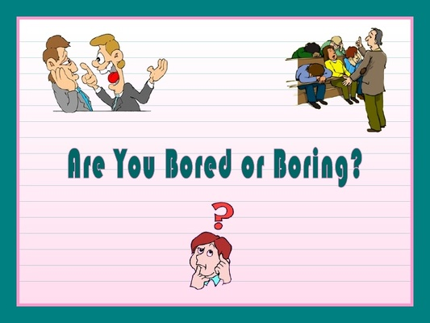

Slide 5
Excited
Exciting

Slide 6
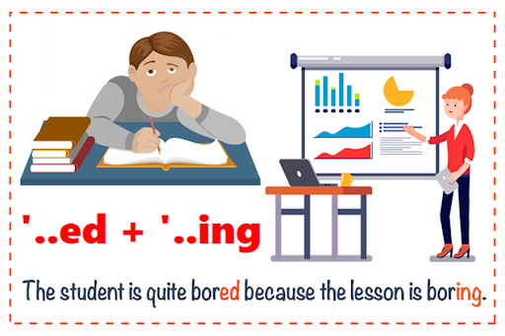

Slide 7
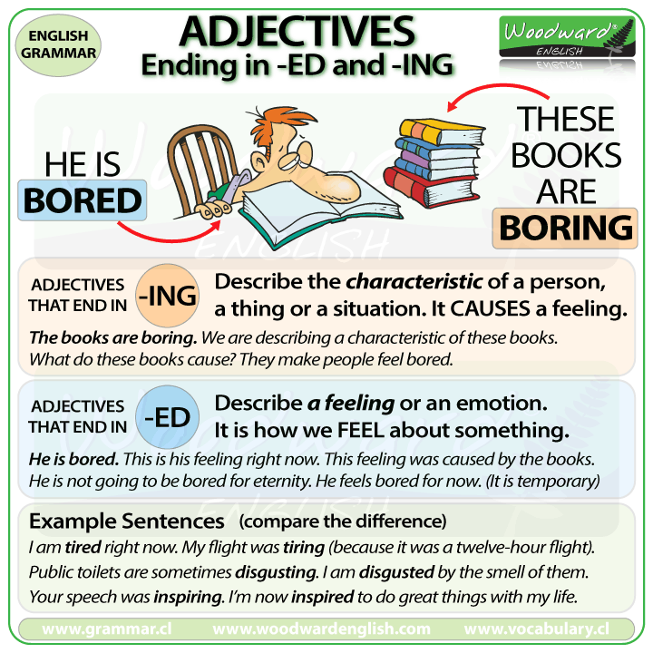

Slide 8
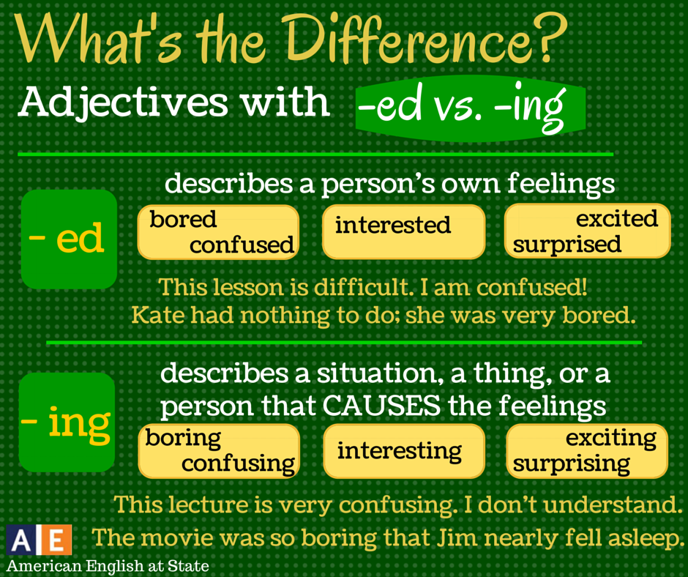

Slide 9
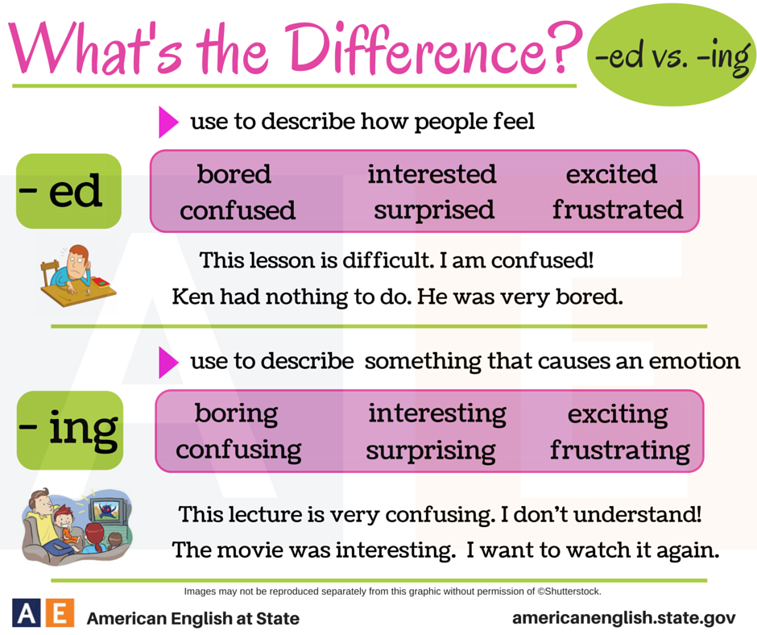

Slide 10

John is interested in art.
Denise was bored in class.
Luke is excited about his new job
John is an interesting person
The class was boring so Denise fell asleep.
Luke started an exciting new job.

Slide 11
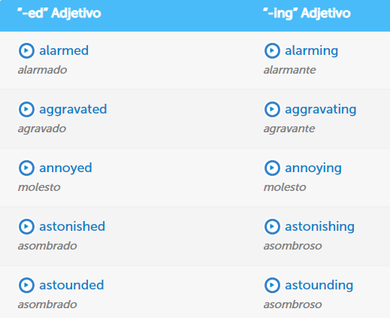
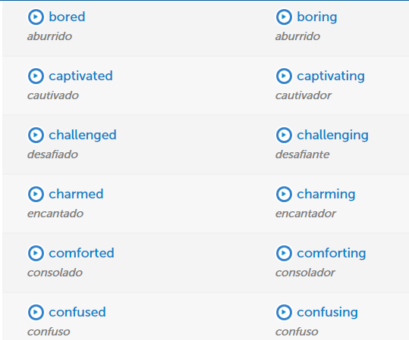

Slide 12
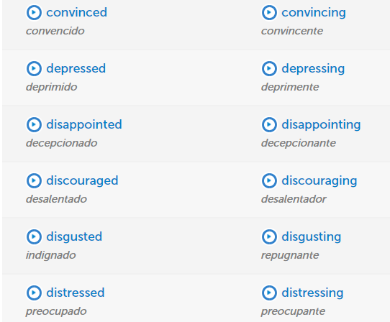
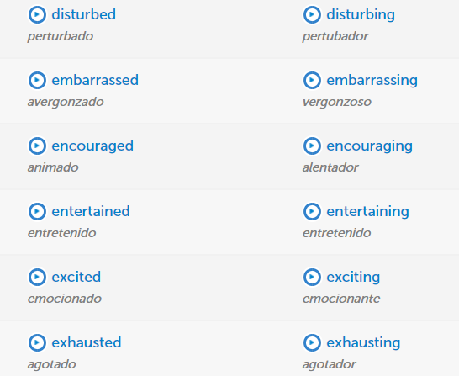

Slide 13
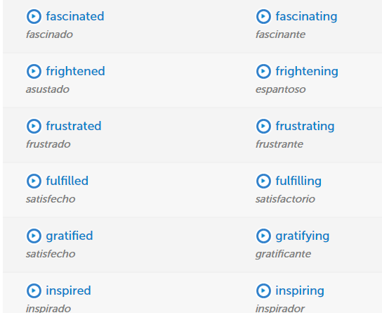
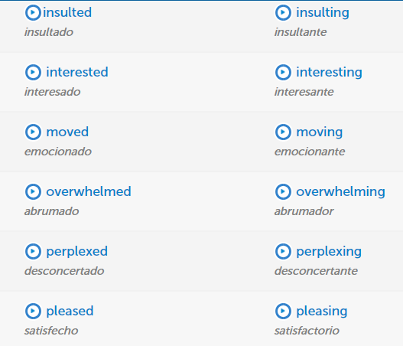

Slide 14



Slide 15
SOURCES
https://www.youtube.com/watch?v=fHh0rXJ_AWU (English and Spanish explanation)
https://www.youtube.com/watch?v=GH-CrtpahjA (English explanation)
https://www.youtube.com/watch?v=nqsfLRsaCco (quiz to practice)
https://learnenglish.britishcouncil.org/grammar/beginner-to-pre-intermediate/adjectives-ending-in-ed-and-ing
https://www.youtube.com/watch?v=cKMMnLOBQ60 (quiz)

